Slide 1
AIR TRAFFIC DATA ANALYSIS
.

Slide 2
Presented by
Naveen Kumar (Roll no-CSE/16019/176)
Rohit Kumar (Roll no-CSE/16031/186)

Slide 3
Mentored by
Dr. Sanjay Chatterji
Prof. CSE Department,
IIIT Kalyani , W.B

Slide 4
Content
Introduction
Motivation
Data Set Description
Trajectory Exploration
Parallel coordinates
Model of Visualization
environmental considerations
Flight map
References

Slide 5
Introduction
Overview
The goal of Air Traﬃc Control (ATC) is to maximize both safety and capacity, so as to accept all ﬂights without compromising the life of the passengers or creating delays.
Air traﬃc is expected to double by 2030, new visualizations and analysis tools have to be developed to maintain and further improve the safety level.

Slide 6
Introduction
To do so, air traﬃc practitioners analyze data from the ATC activity.
This multidimensional data includes aircraft trajectories (3D location plus time), ﬂight routes meteorological data, etc.
The special properties of ATC data propose new challenges and, at the same time, new opportunities of data analysis.

Slide 7
Motivation
Aircraft trajectories are monitored and recorded by ground radar. It is displayed in real-time on radar screens.
This data is essential for air traﬃc controllers, in order to maintain a safe distance between air craft and to optimize traﬃc ﬂuidity (reduce ﬂight time, noise and fuel consumption).

Slide 8
Data Set Description
In this section, we have taken a data set that is containing the data about the number of ﬂights that have travelled from one destination to other destination with time gap of monthly, Quaterlly or yearly. And total number of passengers that have travelled in that time period
We have taken names of few ﬂights of national and international airlines and rate of change of passenger trafﬁce montly or quaterly and also top ten airlines having more trafﬁcs
Top 100 airport pairs with highest traffic inflow and outflow combined
Below is a snapshot of 20 of them

Slide 9
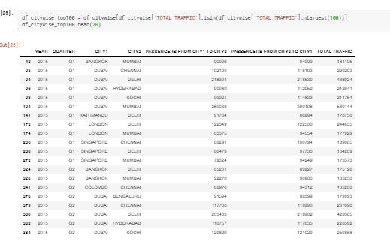

Slide 10
Trajectory Exploration
1.View conﬁguration
. The system must permit the customization of views so as to offer multiple means of understanding and visually querying the data. It should allow for a change of mapping between data and visual dimensions. The system should also provide smooth transitions between visual conﬁgurations. Hence, the user will be able to visually track patterns between different view conﬁgurations.
2 .View rganization
Views organization and navigation: The system must also permit the display of multiple views .Theuse rmustbeable tovisually comparedifferentvisual conﬁgurations of the data set. This can be done with a matrix scatterplot or juxtaposed views

Slide 11
Graphical depiction of busiest airport pairs
Dubai - Mumbai is arguably the busiest route with a whopping 4.5 million passengers flying both ways in 3 years
Take a look a the table below the graph. Flights fly in and out of Dubai to 5 Indian cities of the top 10 airport pairs.
A considerable number of flights fly in an out of London and (Delhi, Mumbai)
3d graphs and 10 airport pairs in plot

Slide 12
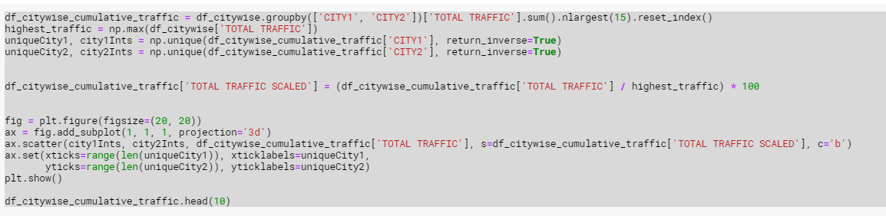
3d graphs and 10 airport pairs

Slide 13
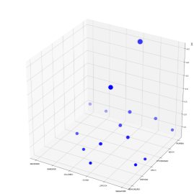
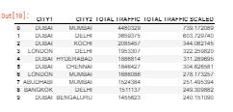
Flight map of all traffic flowing in and out of India
Find out all unique cities from the citywise csv and geocode them to find their latitude and longitude. I used GeoPy for achieving this.
Once I have lat, long information of arrival and departure airports, I used the Flight Visualization with Pandas and Matplotlib by Hugo Larcher.
Combining the two, the visualization of flight data of our dataset can be viewed.

Slide 14
Parallel coordinates
Parallel coordinates are a two-dimensional technique to visualize multidimensional datasets Parallel coordinates are one of the most popular visualization techniques where attributes are represented as axes and data items are represented as lines linking the axes
They have been thoroughly studied and Siirtola and Räihä provide a good review of interaction techniques for parallel coordinates Most known techniques are brushing and rearrangement by direct manipulation

Slide 15
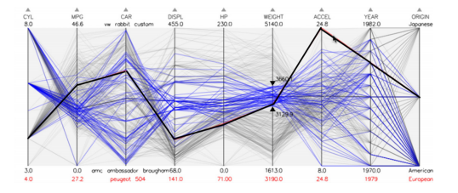
Parallel coordinates Visualization

Slide 16
Model of Visualization
A visualization system is not just a system to create an image of the data but can be used to manipulate the data to create different types of images.
A model of a visualization system should link the system with the model of scientific investigation discussed above.
Visualization can help form the link between hypothesis and experiment and between insight and revised hypothesis.
The developed model consists of a set of abstract modules. It is a controlled dual dataflow system.

Slide 17
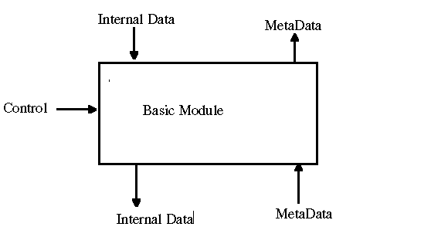
The Control is perfomed by the User. The internal data is the data the module works on and transforms.

Slide 18
Data Access modules allow
A Data Import module imports data from an external source. Different Data Import modules will import different types of data.
A Data Export module exports data, as with the importing of data, different modules will export different types of data.
A Command Interpreter translates command data into control data for other modules in the visualization system.
A Command Sequencer module allows for sequence of command data, for an animation.

Slide 19
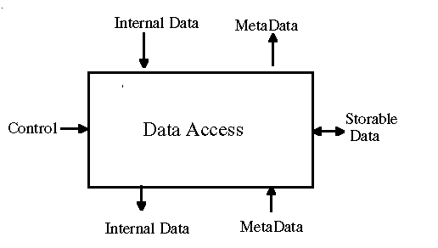
Data Access modules allow data to be stored and/or retrieved, perhaps in a format specific to the visualization system.

Slide 20
Finally environmental considerations can be detailed as:
Compare trajectories with environmental considerations (fuel consumption, noise pollution, vertical proﬁle comparison),
Detect missed approach trajectories (which produce noise), lap training Landings (pilots who train to take oﬀ, ﬂy around the air ﬁeld and land. Lap training landings consume a lot of fuel), and
Count continuous descending aircraft (since these aircraft maintain a constant descent rate, they reduce their fuel consumption).

Slide 21
Flight map of all traffic flowing in and out of India
Flight map of all traffic flowing in and out of India
Find out all unique cities from the citywise csv and geocode them to find their latitude and longitude. I used GeoPy for achieving this.
Once I have lat, long information of arrival and departure airports, I used the Flight Visualization with Pandas and Matplotlib by Hugo Larcher.
Combining the two, the visualization of flight data of our dataset can be viewed.

Slide 22
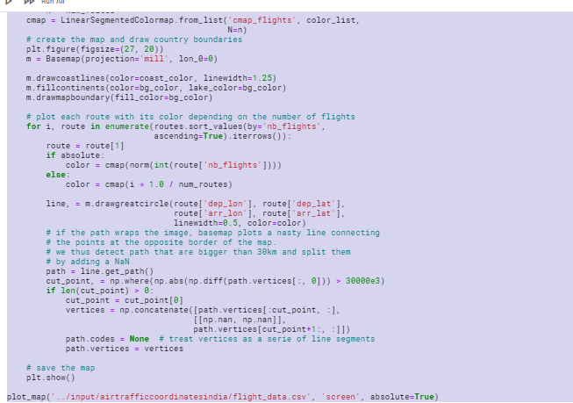
Flight map code

Slide 23
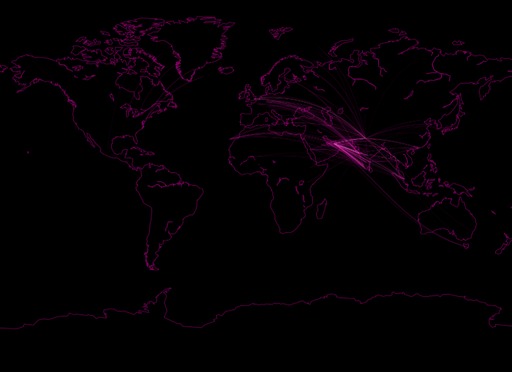
OUTPUT :-

Slide 24
References:-
https://www.kaggle.com
http://geoanalytics.net/and/papers/mobibook13a.pdf
Abul , O., Bonchi , F., and Giannotti, F. 2010. Hiding sequential and spatiotemporal patterns. IEEETransactionsonKnowledgeandDataEngineering,22(12),1709– 1723.
Barab´asi , A. L., and Albert, R. 1999. Emergence of Scaling in Random Networks. Science,286, 509.
https://www.bts.gov/explore-topics-and-geography/topics/air-traffic-data

Slide 25
THE END
Thank you!

